Slide 1
Image Colorization using Conditional Wasserstein GANs
SOHAN ARUN
Notes:
Hi, everyone — I'm Sohan Arun, and today I'll be presenting my project on "Image Colorization using Conditional Wasserstein GANs." which explores using generative adversarial networks to transform grayscale images into realistic pausible images.

Slide 2
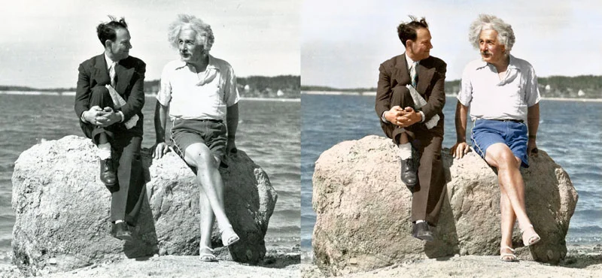
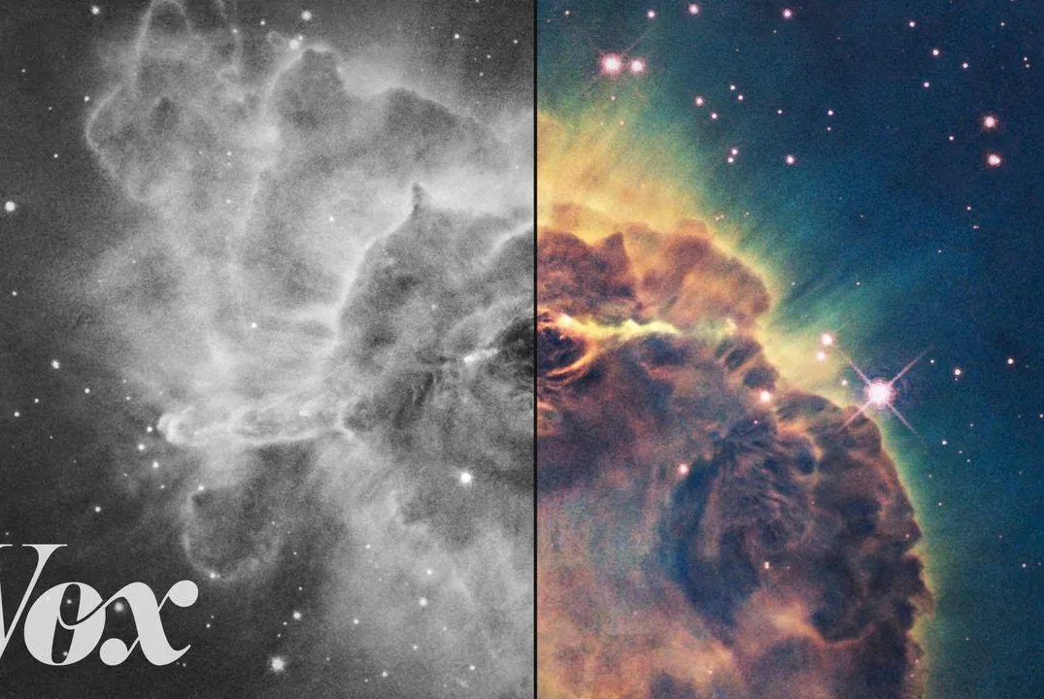
Motivation
Revive historical photos & films
Enhance scientific, medical & artistic imagery
Reduce manual effort & subjectivity in hand-coloring
Notes:
The motivation behind this project comes from the potential impact automatic image colorization can have across various fields.
In cultural preservation, it brings new life to historical photographs and films, making them more engaging and accessible to the public through archives and museums.
In domains like medicine, remote sensing, and art restoration, adding color enhances both the clarity and aesthetic value of otherwise monochrome data.
Unlike traditional manual colorization, which is labor-intensive and subjective, an automated model can significantly reduce effort while maintaining a high degree of realism and consistency.

Slide 3
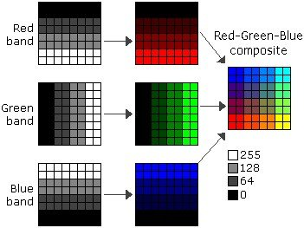
Problem Definition
Automatically add plausible color to grayscale images
One grayscale input → multiple valid color outputs
Challenging due to ambiguity and lack of ground truth
Notes:
The core problem that is being addressed is, taking a grayscale image and generating a full-color version that looks natural and realistic.
What makes this difficult is the inherent ambiguity: where a single grayscale image can correspond to many plausible color versions. For example, a gray shirt could be red, blue, or green—there’s no definitive answer unless context is provided.

Slide 4
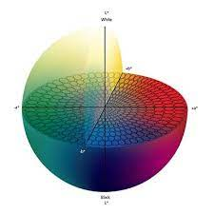
Methodology
CIELAB Color Space (LAB*)
Separates lightness (L*) from color (a*, b*)
L* = grayscale input; model only predicts a* & b*
Reduces complexity of colorization task
Closer to human color perception than RGB
Enables focused learning on chrominance
Notes:
this project was to operate in the CIELAB color space, also known as L*a*b*. This color space separates an image into three distinct channels:
L* for lightness or grayscale intensity,
a* for green–red chromatic variations, represented by the x axis, and
b* for blue–yellow chromatic variationsrepresented by the y axis.
By feeding only the L* channel into the model, we allow the generator to focus solely on predicting the a* and b* components—essentially, the color.
This separation of luminance and chrominance simplifies the learning problem significantly compared to predicting all RGB channels from scratch.
Moreover, CIELAB is perceptually uniform, meaning equal changes in values correspond to roughly equal changes in human perception. This makes it more aligned with how we perceive color differences, making the predictions more visually meaningful.

Slide 5
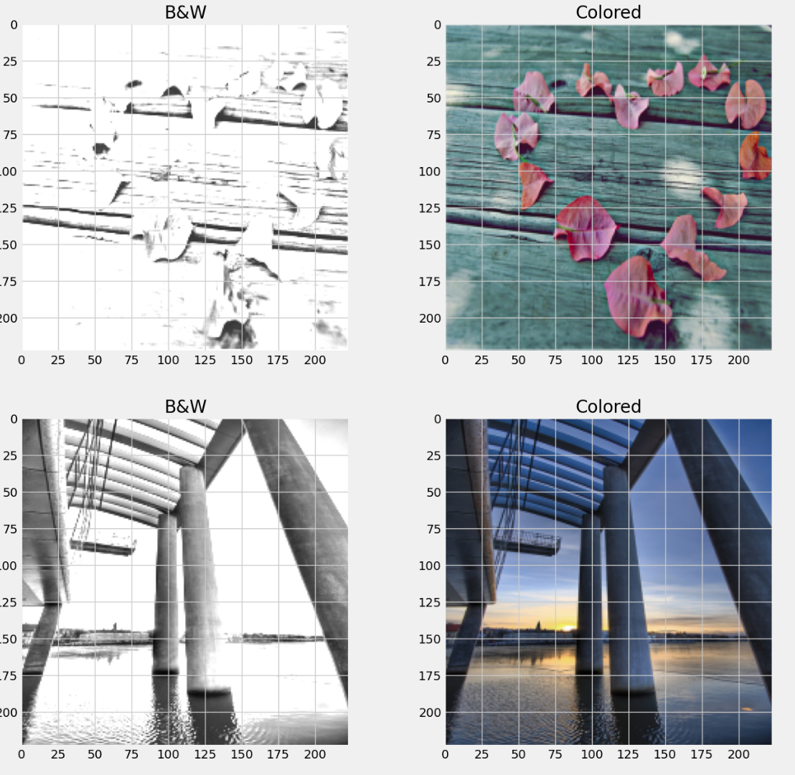
Methodology
Dataset & Preprocessing
Total Images: 25,000 photographs
Source: Flickr (via Kaggle)
Annotations: 24 semantic categories, 1,386 unique tags
Notes:
The dataset used in this study was sourced from the MIR-FLICKR25k image collection, which comprises 25,000 high-
quality color images annotated with user-generated tags and categorized into 24 semantic groups.
While the original dataset consists solely of RGB images, a preprocessed version made available by the Kaggle community was utilized in this work.
In this version, each image was converted into the L*, a*, and b* channels of the Lab* color space and stored as .npy NumPy arrays.
Due to time constraints, a subset of 5,000 image pairs, each resized to 224 × 224 pixels, was selected for both training and evaluation.
During data loading, the NumPy arrays were converted to tensors, which inherently normalized
the pixel values to the [0, 1] range.

Slide 6
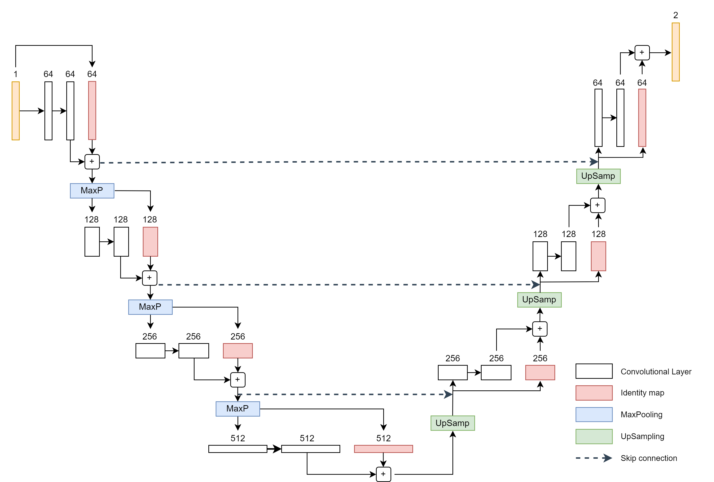
Methodology
Generator Architecture: ResU-Net
U-Net structure: encoder–decoder with skip connections
Encoder: stacked conv + max-pool layers, doubles feature maps
Decoder: transposed conv (upsampling), halves feature maps
Residual blocks improve feature learning & gradient flow
Skip connections restore fine details across layers
Dropout added to reduce overfitting
Notes:
the generator is implemented as a ResU-Net, which is a hybrid of the U-Net structure combined with residual learning. It takes in a single-channel L* image of size 1×224×224—representing lightness—and outputs a two-channel ab image of size 2×224×224, which contains the chrominance values.
The design follows an encoder-decoder structure with skip connections, allowing for both global context and fine detail preservation.
Encoder:
Each encoder block begins with a 2×2 max pooling layer with a stride of 2, followed by a residual block. The ResBlock contains two 3×3 convolution layers, each followed by batch normalization and ReLU activation. An identity shortcut is added to allow residual learning. As we go deeper in the encoder, the feature depth doubles—starting from 64 and going up to 512. This helps the network learn increasingly abstract features.
Bridge:
At the bottleneck of the network, we have a single ResBlock that captures the most abstract features before decoding begins.
Decoder:
Instead of using transposed convolution—which often introduces checkerboard artifacts—we apply bilinear interpolation for up-sampling. The up-sampled features are then concatenated with the corresponding encoder outputs via skip connections, and passed through another ResBlock. Here, the feature depth is reduced symmetrically—from 512 back down to 64. And because we use symmetric padding throughout, no cropping is needed, and the feature maps stay perfectly aligned.
Residual Blocks:
Each ResBlock uses the structure: convolution → batch norm → ReLU → convolution → batch norm → addition → ReLU. This configuration helps preserve gradients and encourages deeper reuse of features, which is particularly useful in deep networks like this one.
Regularization:
To prevent overfitting, we apply a dropout rate of 0.2 after each encoder block and the bridge. We deliberately leave the decoder path dropout-free, so the model can retain all the fine details during reconstruction.

Slide 7
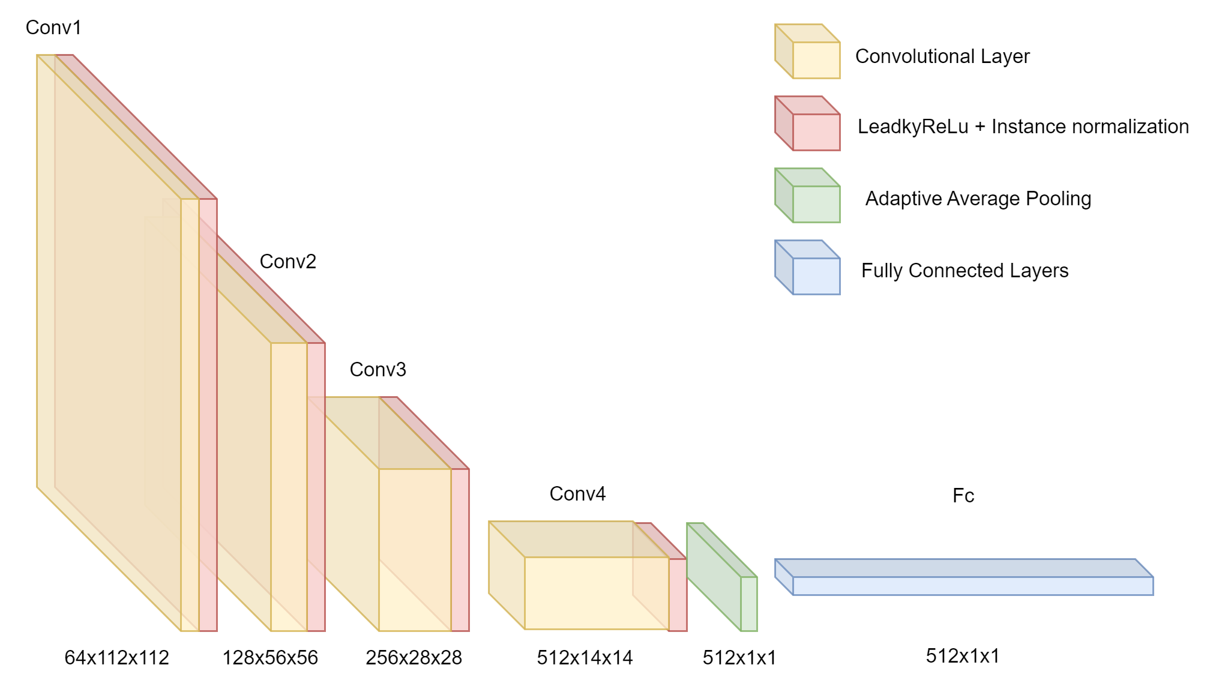
Methodology
Critic Architecture
U-Net structure: encoder–decoder with skip connections
Encoder: stacked conv + max-pool layers, doubles feature maps
Decoder: transposed conv (upsampling), halves feature maps
Residual blocks improve feature learning & gradient flow
Skip connections restore fine details across layers
Dropout added to reduce overfitting
Notes:
The critic is implemented as a Convolutional Neural Network. Its main purpose is to evaluate the authenticity of colorized images by determining whether they come from the real dataset or are generated by our model.
The input to the critic is a 3×224×224 tensor, which is created by concatenating the L* channel—the grayscale image used for conditioning—with either the ground truth a*b* channels or the a*b* channels predicted by the generator. This allows the critic to evaluate both context and colorization quality.
The network is composed of several convolutional blocks. Each block typically includes:
A 4x4 convolutional layer with a stride of 2 for downsampling,
Followed by Instance Normalization—except in the very first block,
And a LeakyReLU activation with a slope of 0.2 to introduce non-linearity.
As we go deeper into the network, the number of filters increases progressively: starting from 3 channels and expanding to 64, 128, 256, and finally 512 filters, while the spatial dimensions reduce.
Once the convolutional blocks finish processing, we apply an adaptive average pooling layer. This reduces each feature map to a single scalar value, effectively summarizing the feature’s presence in the image. Then, we flatten this output and pass it through a final linear layer, which gives us one scalar score.
This score is then used in the Wasserstein loss function to measure how 'real' or 'fake' the image colorization appears.

Slide 8
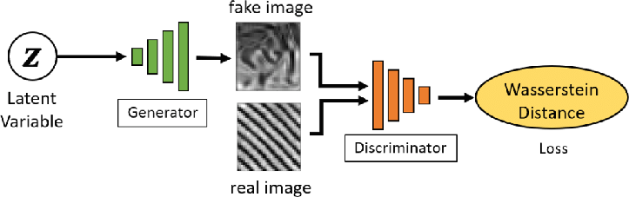
Methodology
Conditional WGAN-GP Framework
Generator & Critic both conditioned on grayscale L* channel
Critic maximizes: D(real) − D(fake) → Wasserstein distance
Gradient Penalty (GP): enforces 1-Lipschitz constraint
R1 Regularization: penalizes sharp gradients for smooth learning
Generator optimized via L1 loss (no explicit adversarial loss)
Alternating training drives realistic and stable outputs
Notes:
the adversarial training strategy used in our colorization model, both the generator and the critic are explicitly conditioned on the grayscale L* channel. This ensures that the critic evaluates the plausibility of generated colorizations in context with the original input image.
The critic’s objective is to maximize the Wasserstein distance between real and generated samples. This is a more stable and meaningful measure of distribution similarity compared to traditional GAN loss functions.
To enforce the necessary constraint on the critic, we implement a Gradient Penalty. This regularization term penalizes the critic if the gradient norm with respect to interpolated inputs deviates from 1, promoting smooth and controlled learning behavior.
Additionally, we apply R1 Regularization, which further stabilizes the critic by discouraging overly sharp gradient changes. This is particularly beneficial for generalization and training robustness.
On the generator side, we avoid direct adversarial loss. Instead, we apply an L1 reconstruction loss between the predicted ab channels and the ground truth, encouraging pixel-wise accuracy while still benefiting from adversarial feedback through alternating updates with the critic.

Slide 9
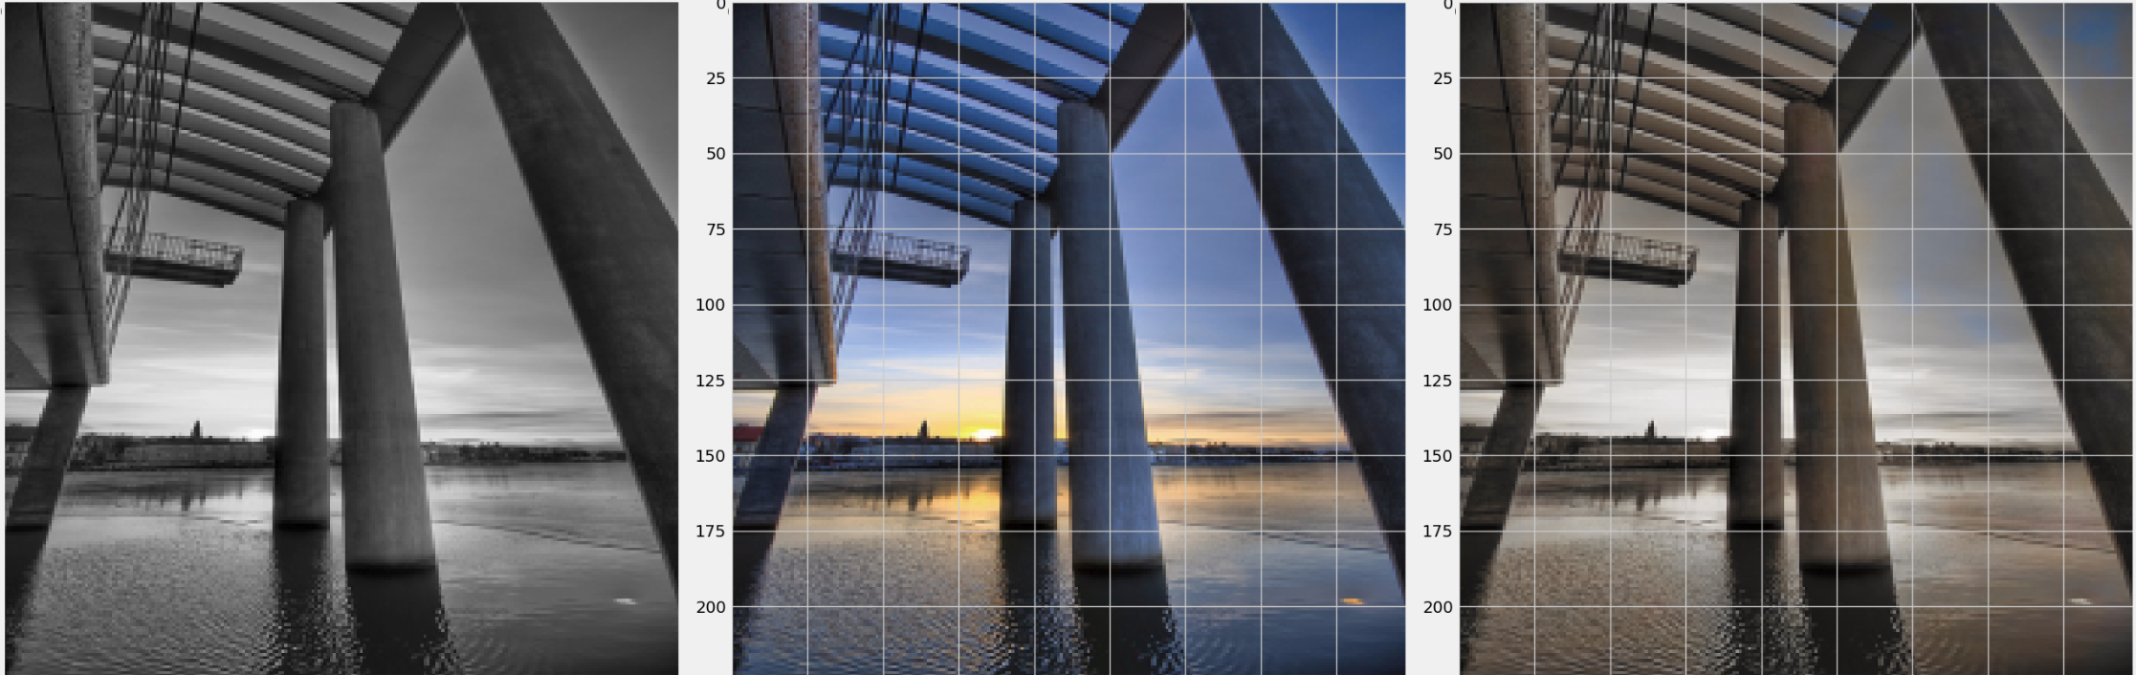
Results & Discussion
Notes:
Here are some Examples of image colorization. From left to right Input
Grayscale, Ground Truth Color, Generated Color.

Slide 10
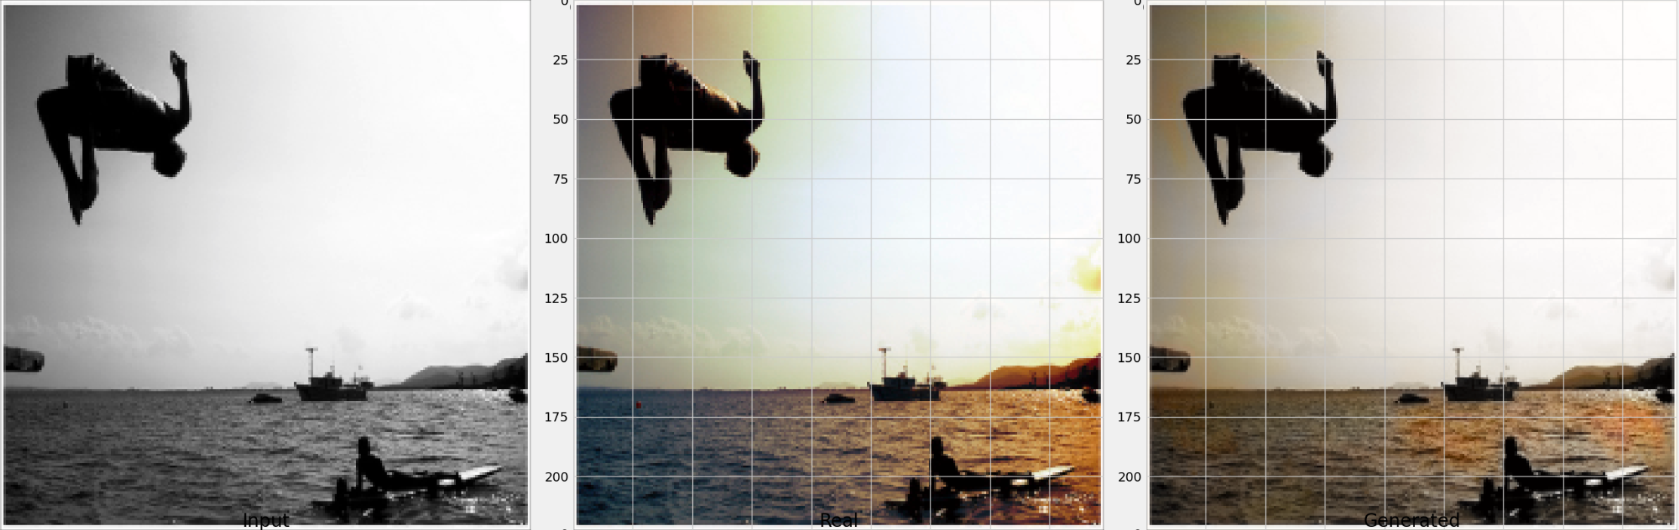
Results & Discussion

Slide 11
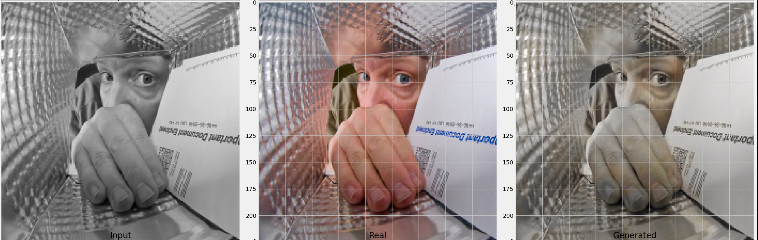
Results & Discussion

Slide 12
Results & Discussion
Inception Score (IS): Generated: 4.31 ± 1.84 Real: 4.34 ± 1.80
Fréchet Inception Distance (FID): 13.11
Qualitative results: visually plausible & consistent colors
Some limitations
1. Minor color bleeding
2. Oversaturation
3. Model performance depends on scene complexity & lighting
Notes:
Starting with quantitative results:
The Inception Score (IS) for generated images was 4.31 ± 1.84, which is nearly identical to the IS of the real images (4.34 ± 1.80). This indicates that the generated images are not only recognizable but also diverse in content.
The FID scor was measured at 13.11, suggesting a close alignment between the feature distributions of real and generated images in the Inception network's latent space. Lower FID scores are generally preferred, as they reflect higher realism and quality.
On the qualitative side, the model successfully produced visually coherent colorizations. It maintained strong semantic consistency with the input grayscale image, assigning colors that were contextually appropriate in most cases.
The use of skip connections in the U-Net and residual blocks in the ResU-Net helped preserve fine details, especially at object boundaries.
However, a few limitations were observed:
Some images showed slight color bleeding beyond object borders
patches that may appear somewhat dull or, conversely, overly saturated
Fidelity of colorization can vary depending on the complexity, such as uniqueness of the objects, and the subtlety of the lighting conditions.
To conclude, The model generally performed better on well-lit, common scenes, and faced challenges with unusual textures or ambiguous lighting conditions.

Slide 13
THANK YOU

